Slide 1
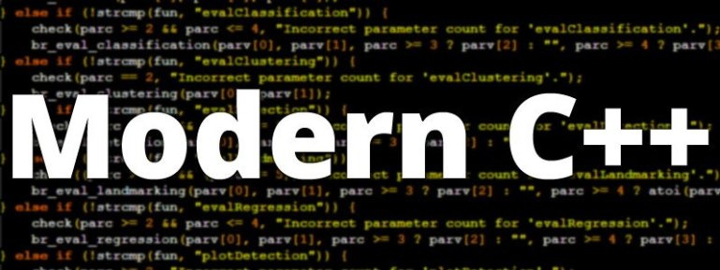
ADVAnce C++

Slide 2
MODERN C++
Introduction To Iterators
Declaring Iterator
Initializing Iterator
Operators Supported By Iterator
Reverse Iterator
Examples

Slide 3
Introduction to iterators
The concept of an iterator is fundamental to understanding the C++ Standard Template Library (STL) .
This is because iterators provide a means for accessing data stored in container classes such a array ,vector , map , list, etc.

Slide 4
What is an iterator ?
An iterator is an object that points to an element inside the container.
They can be visualised as something similar to a pointer pointing to some location and we can access the content at that particular location using them.

Slide 5
Advantages of iterators
The main advantage of an iterator is to provide a common interface for all types of containers.
Iterators make the algorithm independent of the type of the container used.
Iterators provide a generic approach to navigate through the elements of a container.
Special Note: Container adapters do not support iterators

Slide 6
Why container adapters do not support iterators ?
The three container adapters are not classic containers rather they are restricted versions of underlying container.
They provide specialized access to the underlying containers and so they do not offer iterators or subscripting.

Slide 7
Declaring iterator
An iterator must be declared based on the container type it will iterate over.
Syntax:
container-name<data-type>::iterator iterator-name;
Examples:
vector<int>::iterator vi;
list<int>::iterator li;
array<int,5>::iterator ai;
// for array iterator size is reqd

Slide 8
Initializing iterators
Almost every container provides us 2 methods called begin() and end() .
The method begin() returns us an iterator to the first element in the container while the method end() returns us the iterator to the element after the last element.

Slide 9
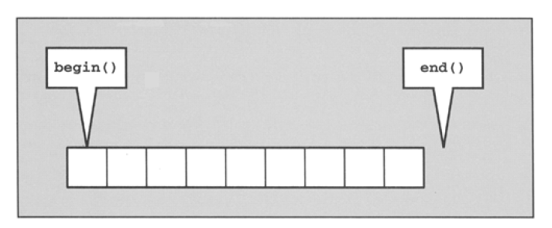
Begin() and end()

Slide 10
Code for initializing iterator
Examples:
First Way:
array<int,5>arr={10,20,30,40,50};
array<int,5>::iterator istart;
array<int,5>::iterator iend;
istart=arr.begin();
iend=arr.end();
Second Way:
array<int,5>arr={10,20,30,40,50};
auto istart= arr.begin();;
auto iend= arr.end();;

Slide 11
Operators supported by iterators
Almost every iterator provides us following operators:
Operator | Purpose
Operator * | Returns the element of the current position
Operator ++ | Allows the iterator to move to the next element
Operator == and != | Checks whether two iterators represent the same position or not.
Operator = | Assigns an iterator to another

Slide 12
Final code-first way
#include <iostream>
#include <array>
#include <iterator>
using namespace std;
int main()
{
array <int,5>arr={10,20,30,40,50};
array<int,5>::iterator start;
array<int,5>::iterator finish;
start=arr.begin();
finish=arr.end();
for(;start!=finish;start++)
{
cout<<*start<<endl;
}
return 0;
}

Slide 13
Final code-second way
#include <iostream>
#include <array>
#include <iterator>
using namespace std;
int main()
{
array <int,5>arr={10,20,30,40,50};
auto start=arr.begin();
auto finish=arr.end();
for(;start!=finish;start++)
{
cout<<*start<<endl;
}
return 0;
}

Slide 14
Final code-third way
#include <iostream>
#include <array>
#include <iterator>
using namespace std;
int main()
{
array <int,5>arr={10,20,30,40,50};
for(auto start=arr.begin();start!=arr.end();start++)
{
cout<<*start<<endl;
}
return 0;
}

Slide 15
reverse iterators
If we want to iterate backwards through a collection we can use a reverse_iterator.
To iterate backwards use rbegin() and rend() as the iterators for the end of the collection, and the start of the collection respectively.

Slide 16
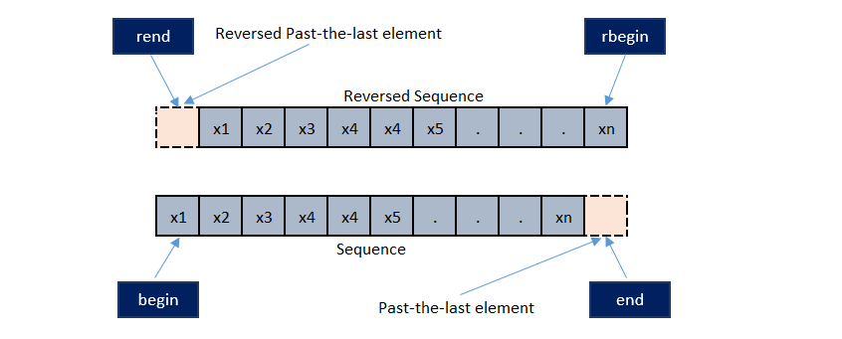
rBegin() and rend()

Slide 17
Final code-first way
#include <iostream>
#include <array>
#include <iterator>
using namespace std;
int main()
{
array <int,5>arr={10,20,30,40,50};
array<int,5>::reverse_iterator start;
array<int,5>::reverse_iterator finish;
start=arr.rbegin();
finish=arr.rend();
for(;start!=finish;start++)
{
cout<<*start<<endl;
}
return 0;
}

Slide 18
Final code-secnd way
#include <iostream>
#include <array>
#include <iterator>
using namespace std;
int main()
{
array <int,5>arr={10,20,30,40,50};
for(auto start=arr.rbegin();start!=arr.rend();start++)
{
cout<<*start<<endl;
}
return 0;
}

Slide 19
Drawbacks of iterators
Iterators do not provide bounds checking and so it is possible to overstep the bounds of a container, resulting inrun time errors like segmentation faults.
Different containers support different iterators, so it is not always possible to change the underlying container type without making changes to our code.
Iterators can be invalidated if the underlying container is changed significantly.

Slide 20
Are iterators and pointer the same thing ?
No
Pointers are variables which can point to a memory location and access its value using indirection operator.
Iterators are generalized pointers used to traverse ANY TYPE of container like array, vector ,and even list ,maps and sets which are non continuous .

Slide 21
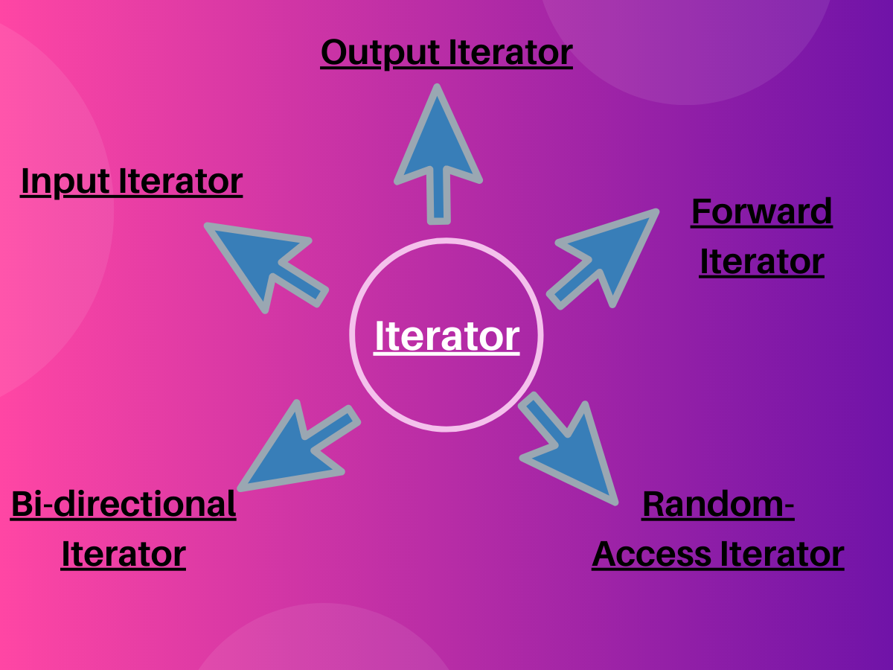
Types of iterators

